Slide 1
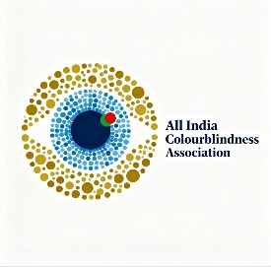

all india Colourblindness association
Colour Blind Awareness CIC is a non-profit organization established in 2022. It supports people with colour blindness and their families, and helps schools, teachers, and businesses understand how to be more inclusive.
Colour blindness is the most common inherited condition in the world, affecting about 320 million people, including around 3 million in the UK. It affects 1 in 12 men and 1 in 200 women.
Although it is a recognised disability and special educational need (SEN), many teachers are unaware of its impact. The organization’s goal is to raise awareness so that colour blind students get proper understanding and support in schools.

Slide 2

What Is Colour Blindness ?
DIFINITION: COLOUR BLINDNESS
( Colour vision deficiency) is a condition where a person has difficulty distinguishing certain colours because the cone ( colour- detecting cells) in the retina are missing, nonfunctional or detect different wavelenghths.
How it work: our eye have three typesof cone cells thst detect red, green and blue light. If some cones don’t work or are absent, colour perceptionis altered.
Inherited vs Acquired:
Inherited: usually gentic, present from birth.
Acquired: can develop later in life due to eye diseases ( like glaucoma, diabetes), damage, or certain medication.

Slide 3
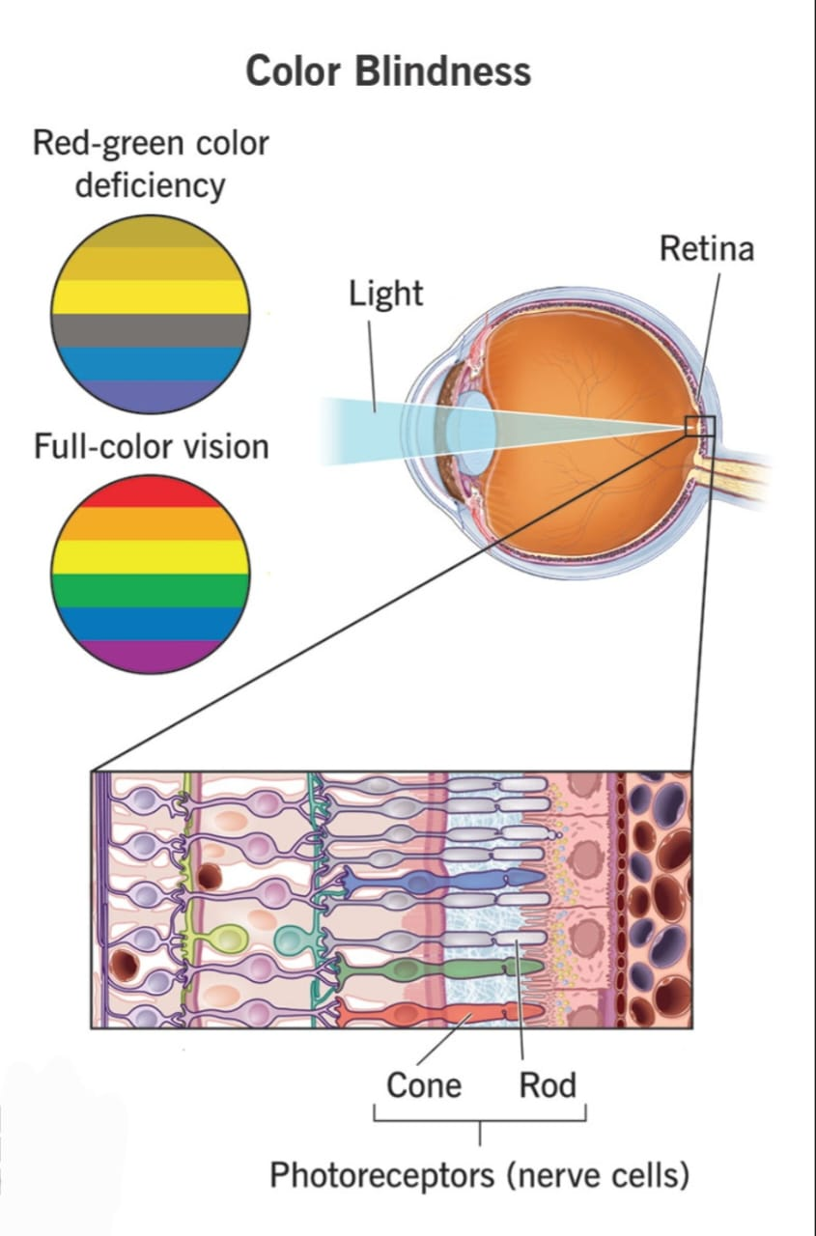

Slide 4
Types of colour blindness:
RED- GREEN
DEFICIENCY
Protanomaly: Red sensing cones don’t work properly ( red look dull)
Deuteranomaly: Green sensing cones are weaker ( green look more red / muted)
Protanopia :missing red cones ( can’t see red and many dark colours.
Deuteranopia : Missing green cones ( trouble distinguishing green)
BLUE- YELLOW DEFICIENCY
Tritanomaly : Blue cones don’t work properly ( blue is muted.
Tritanopia : Missing blue cones (difficulty telling blue from green or yellow from pink
MONOCHROMACY &
ACHROMATOPSIA
Blue Cone Monochromacy: only blue cones work red/ green absent .
Rod Monochromacy: No functioning cone cell, only rods( see in shades of gray, often with poor visual acity, light sensitivity.
GENE THERAPY
(experimental)
There’s research into gene therapy to correct some forms of colour blindness, especially achromatopsia

Slide 5
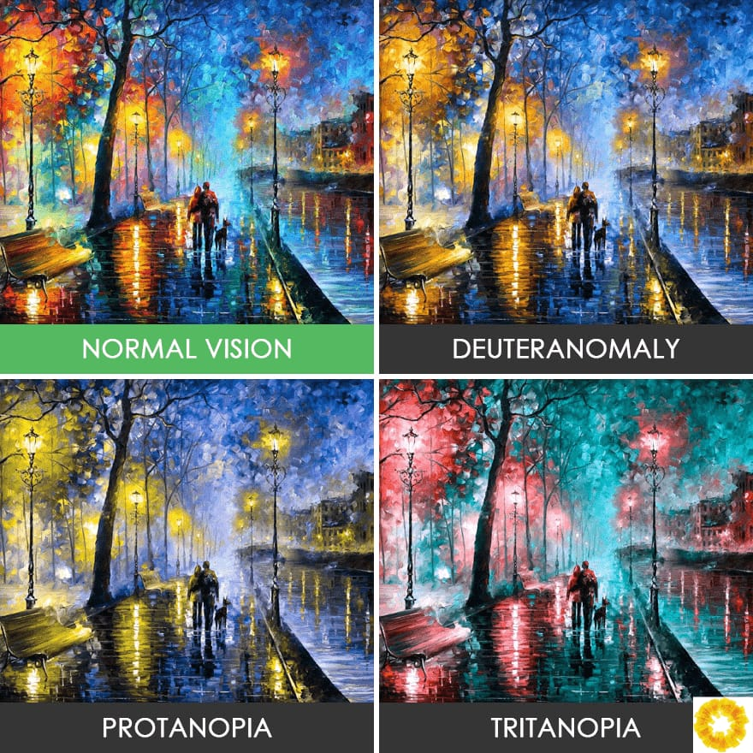
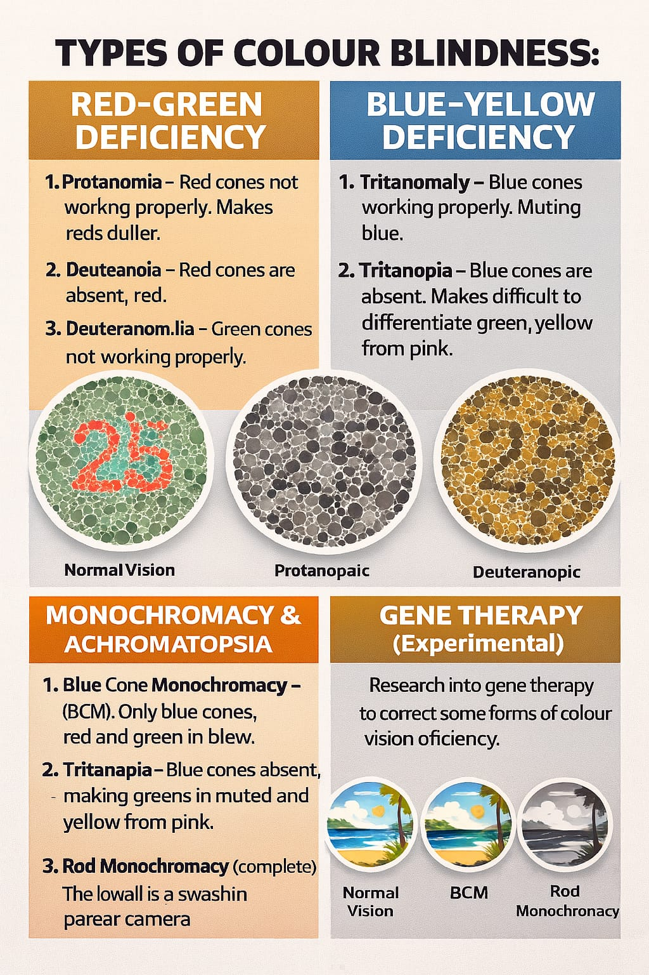


Slide 6
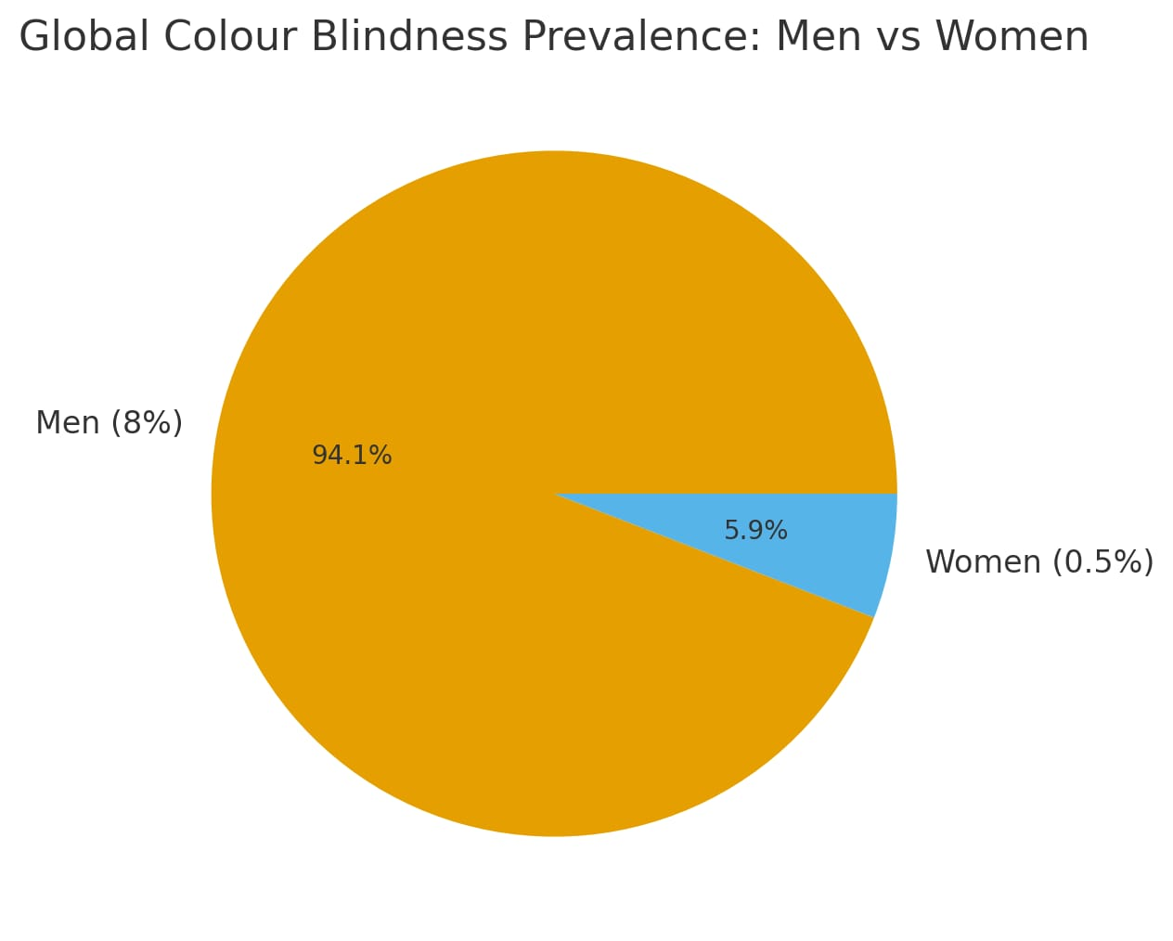
Prevalence & situation in india
According to some sources, about 8% of india men and about 0.5% of women may be colour blind .
In a study of NEET UG ( medical exam) aspirants in delhi, prevealencewas 2.6%.
Ina tribal population (Dehradun) out of 204 males tested, 1.47% were found colour blind ( using the ishihara test) including Protanopia , Deuteranopia and Achromatopsia.

Slide 7



WHY AWARENESS MATTERS IN INDIA
Academic and career limitations: in india some, professions? Jobs may screen our people for colour blindness or not be sensitive to their needs.
Safety : difficulty in distinguishing colour- coded signals can pose risk.
Stigma and misunderstanding: many people don,t understand that colour blindness is not “ seeing in black and white,” and people with it ay feel disadvantage without proper support.

Slide 8
Difficulties /challenges faced by colour blind people
1. IN DAILY LIFE
Difficulties / Challenges Faced by Colour Blind People Here are common issues people with colour blindness face:
1.In Daily Life Difficulty in distinguishing traffic lights (especially red vs green) if positional cues are not there.
2. Problems in choosing or matching clothes, because shades may look different.
3.In school: identifying coloured charts, maps, graphs, or using art supplies.
4.In workplace: Many report challenges — for example, blurred or confusing colour-coded charts, graphs, or wires. According to a survey, 75% of colour-blind workers ask coworkers to verify colours frequently, and over half worry about making mistakes because of their condition.

Slide 9

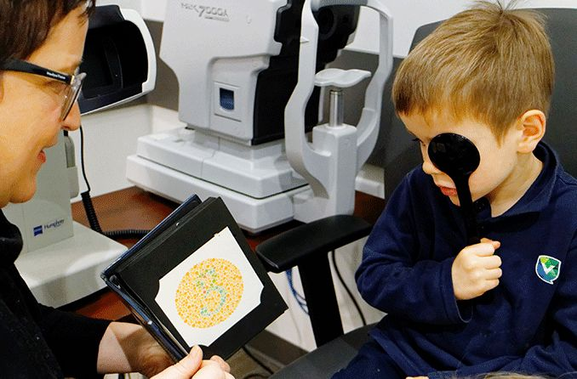

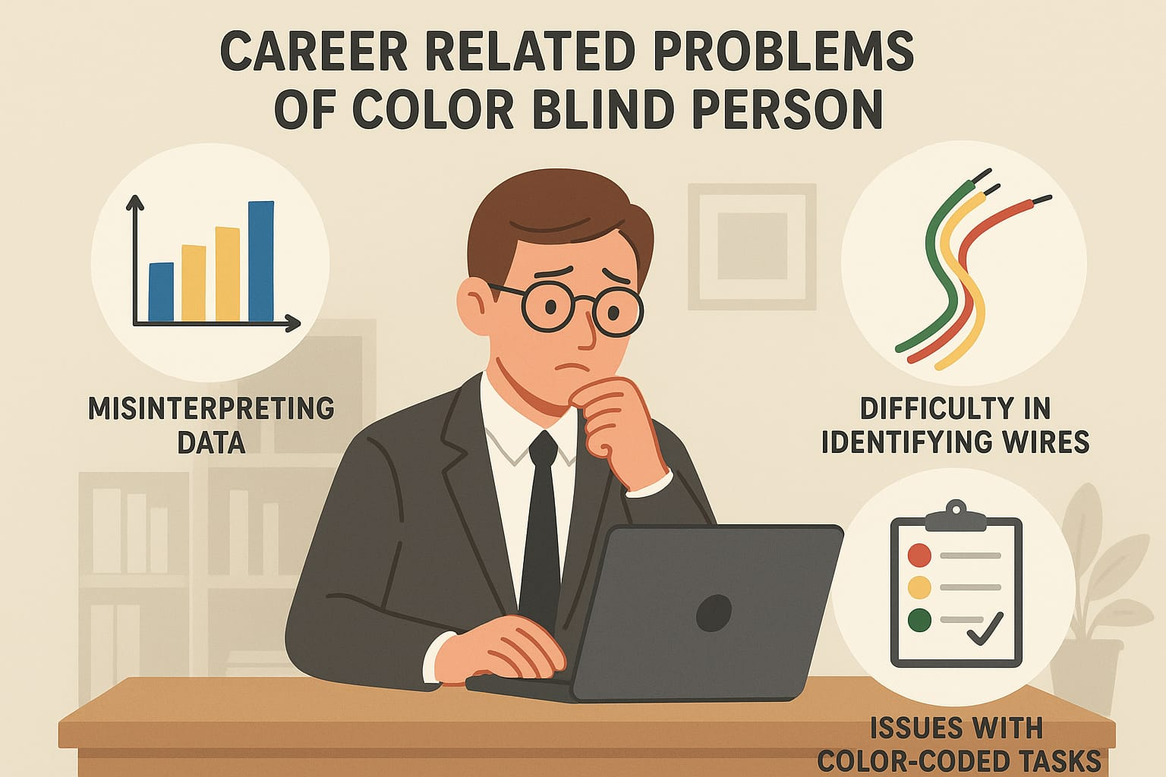

Slide 10
2. Career / Porfessional Limitations
Some industries/professions restrict or disqualify colour-blind people (e.g., certain roles in defense, aviation, electrical, design). In India, career counselling often does not consider how colour blindness can be accommodated; people might choose or be pushed into “safe” careers, limiting their true potential.
3. Psychological / Awareness Issues
Many don’t realize they are colour blind until tests or adulthood. People may feel “different” or disabled; they may avoid fields involving colour even if they have talent. Lack of accommodation: Teachers, employers, or peers may not understand how to support colour vision deficiency.

Slide 11


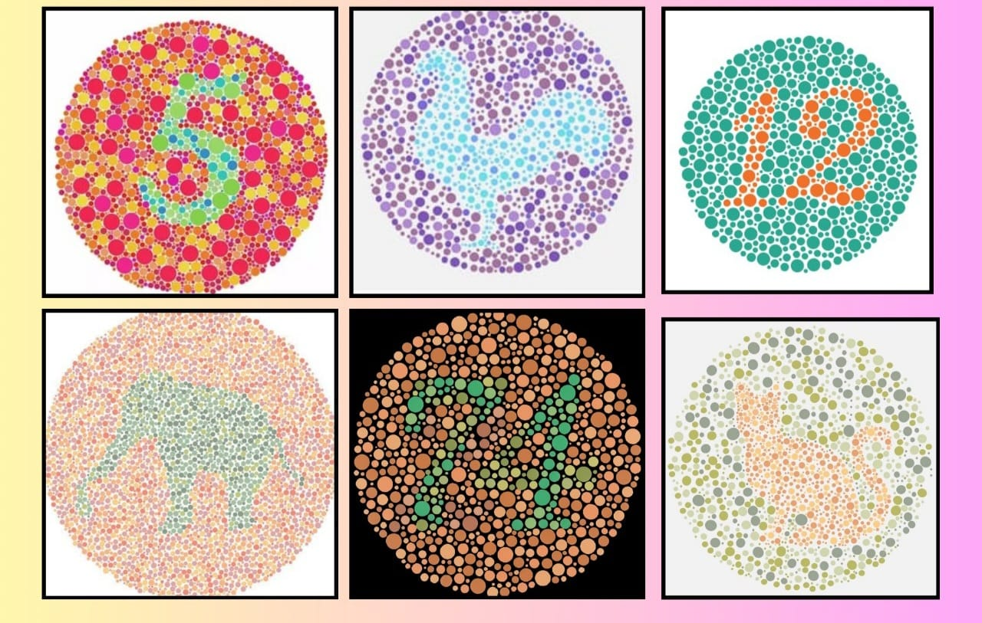
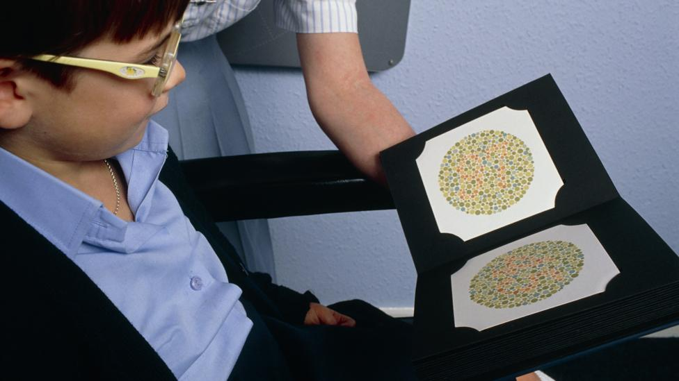

Slide 12


HOW WE CAN RAISE AWARNESS & SUPPORT
1. EDUCATION / AWAERNESS CAMPAIGNS
Use the “Just One Thing” campaign model: teach colour blindness in schools, distribute materials to teachers and parents. Run Ishihara-based screening camps in schools or community centers to identify children early.Include awareness in career guidance: make counsellors and students aware that colour blindness doesn’t have to limit one’s dreams; there are many ways to accommodate.
2. WORKPLACE INCLUSION
Encourage employers to adopt “colour-blind friendly” practices: avoid overly relying on colour-coded info; use labels, patterns or text + colour.Use technology: tools like EnChroma glasses (filters/lenses) can help some people discriminate colours better. Promote accessibility: web developers, UI designers should use colour-blind-friendly palettes; design tools exist to simulate how colour-blind people see.

Slide 13

3. Advocacy & PolicyLobby
for inclusion: push for colour vision tests to be optional or to have accommodations in job selection rather than exclusion. Awareness in driving schools or transport departments: ensure traffic signal systems are friendly (or at least educate colour-blind drivers about positional clues).
4. Support & CommunityBuild
peer groups (online/offline) for colour-blind individuals to share their experiences, coping strategies.Highlight success stories (see below) to inspire others.Encourage the use of assistive tech: besides glasses, there are apps, web extensions, and software that help colour-blind people distinguish colours and navigate daily life. For instance, SightGlow, a web extension, helps adjust colours to someone’s colour vision deficiency.

Slide 14
Examples / success stories
Rabindranath Tagore: There are claims (though not universally confirmed) that he may have had red-green deficiency.
Mark Zuckerberg : While not a traditional political leader, he’s a very influential public figure / tech leader; he is known to be red-green colour blind.
Gaurav Khanna : Indian TV actor known for shows like Anupamaa.He publicly stated in a Times of India interview that he is colour blind and sometimes struggles with colours on set.(Source: Times of India article where he says “I’m colour blind.”)

Slide 15



RABINDRANATH TAGORE
MARK ZUCKERBERG
GAURAV KHANA

Slide 16
ACCESSIBLE SOLUTIONS
1.Education and Training:
School should implement training for teachers to recognize and accommodate colour blind students by using colour blind friendly teaching materials.
2. Technology Adaptation:
Apps and tools that provide colour identification through smartphone cameras can aid individuals in everyday tasks, promoting independences.
3. Legislative Support:
Policies should be introduced that ensure colour blind individuals are not discriminated against in education and the workplaced, fostering an inclusive society

Slide 17

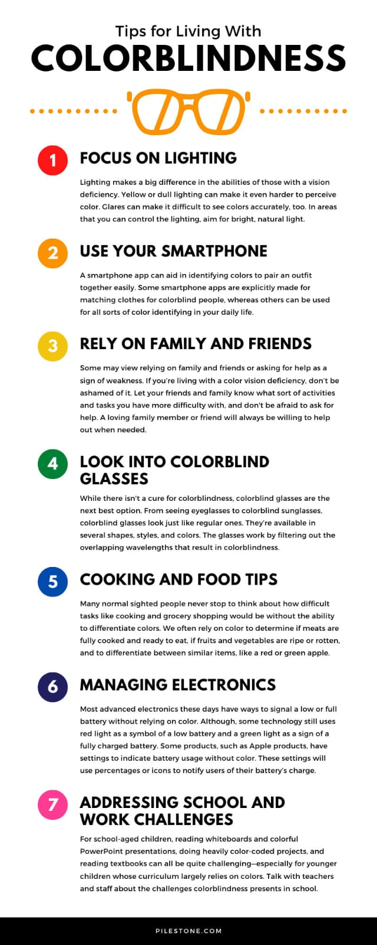

Slide 18


Slide 19




THANK YOU
We are always there for you
Colourblindness1
EMAIL ID:- Colourblindness2025@gmail.com
Contact no:- 9905073802
This Photo by Unknown Author is licensed under CC BY-NC

